Slide 1

Project – 4 feature extraction and price prediction for mobile phones
"A journey through the world of mobile data with advanced analytics techniques"

Slide 2

Project Description:
In this project, I have worked with a dataset that contains detailed information about various mobile phones, including their model, color, memory, RAM, battery capacity, rear camera specifications, front camera specifications, presence of AI lens, mobile height, processor, and, most importantly, the price. My primary goal is to develop a predictive model for mobile phone prices.

Slide 3
Data preprocessing:
Coverted object column into integer like:
Price was 7,299
Now it is 7299
It has been converted by String function
No Missing Values are there
Ordinal Encoding:
This encoding has been used to convert categorical values into numerical format for the columns like:
Model
Colour
Processor
Converted Rear Camera and Front Camera object into integer to remove MP from numerical value, by using lambda function

Slide 4
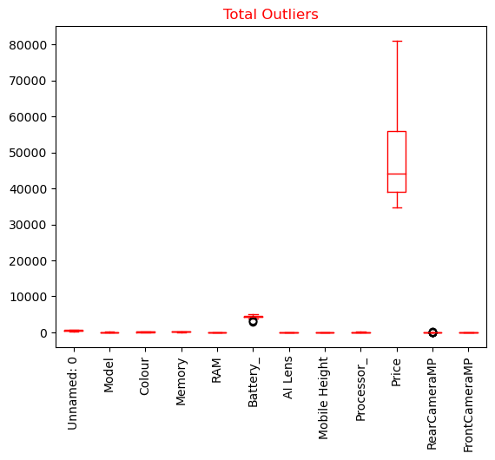
Data preprocessing:
Outliers have been calculated by:
Most affecting features method
Quantile method

Slide 5
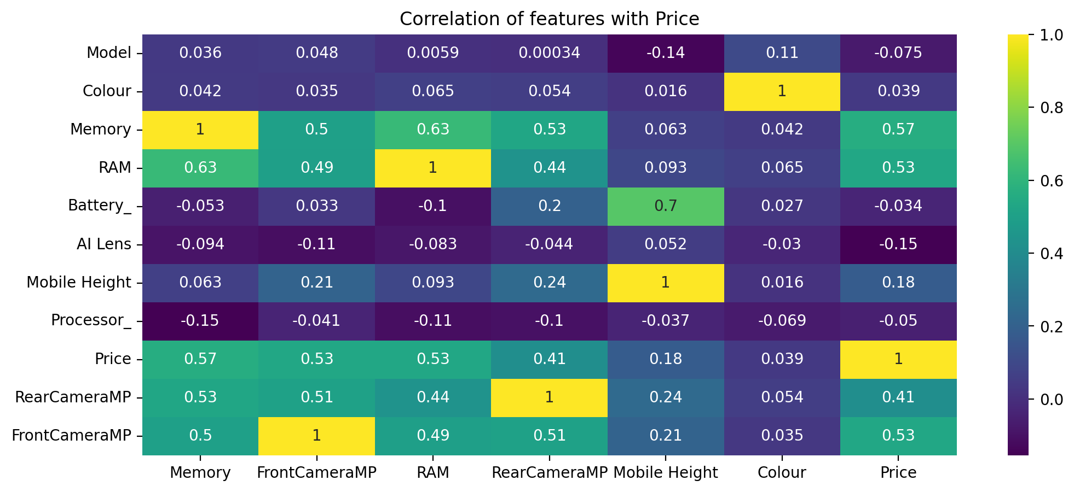
Feature extraction:
Used Correlation Analysis to identify the most relevant features that strongly affect the price
Memory, Front Camera, RAM, Rear Camera are the most important features according to their correlation with Price

Slide 6
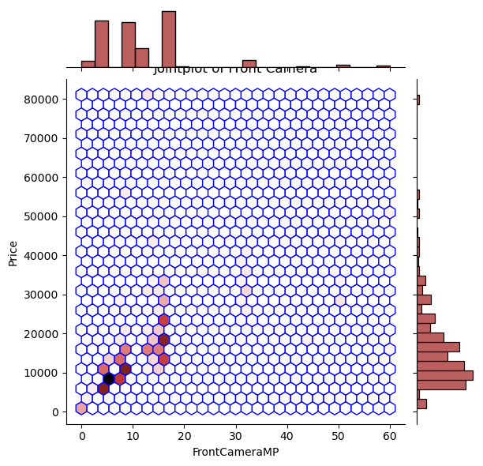
Feature extraction:
Dimensionality Reduction
PCA method has been used for this and the accuracy is 1.0
VISUALIZATION:
Jointplot, Countplot,
Boxplot, Scatterplot
and many other plots
have been used
Visualization
Joint Plot of Front Camera

Slide 7
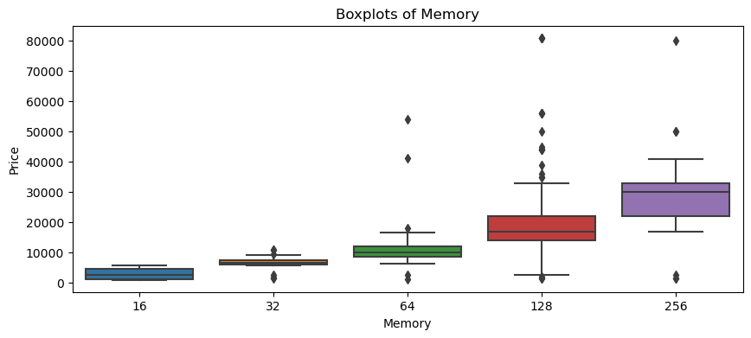
Boxplot of memory
Most relevant feature which affects the Price

Slide 8
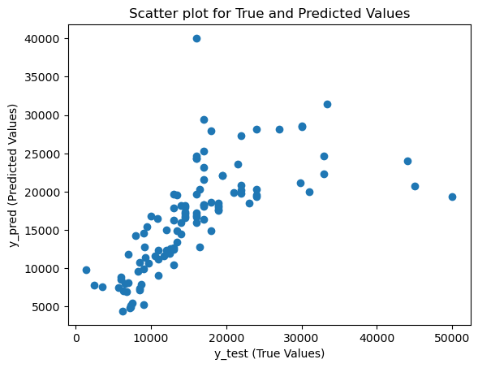
Model building:
LINEAR REGRESSION
Linear
Regression
Decision
Tree
Random Forest
Gradient
Boosting
Score = 0.44

Slide 9
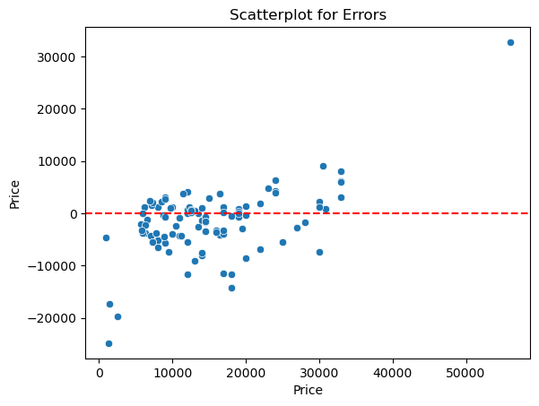
NO CLEAR LINE OR CURVE
SO WE SHOULD NOT USE LINEAR REGRESSION

Slide 10
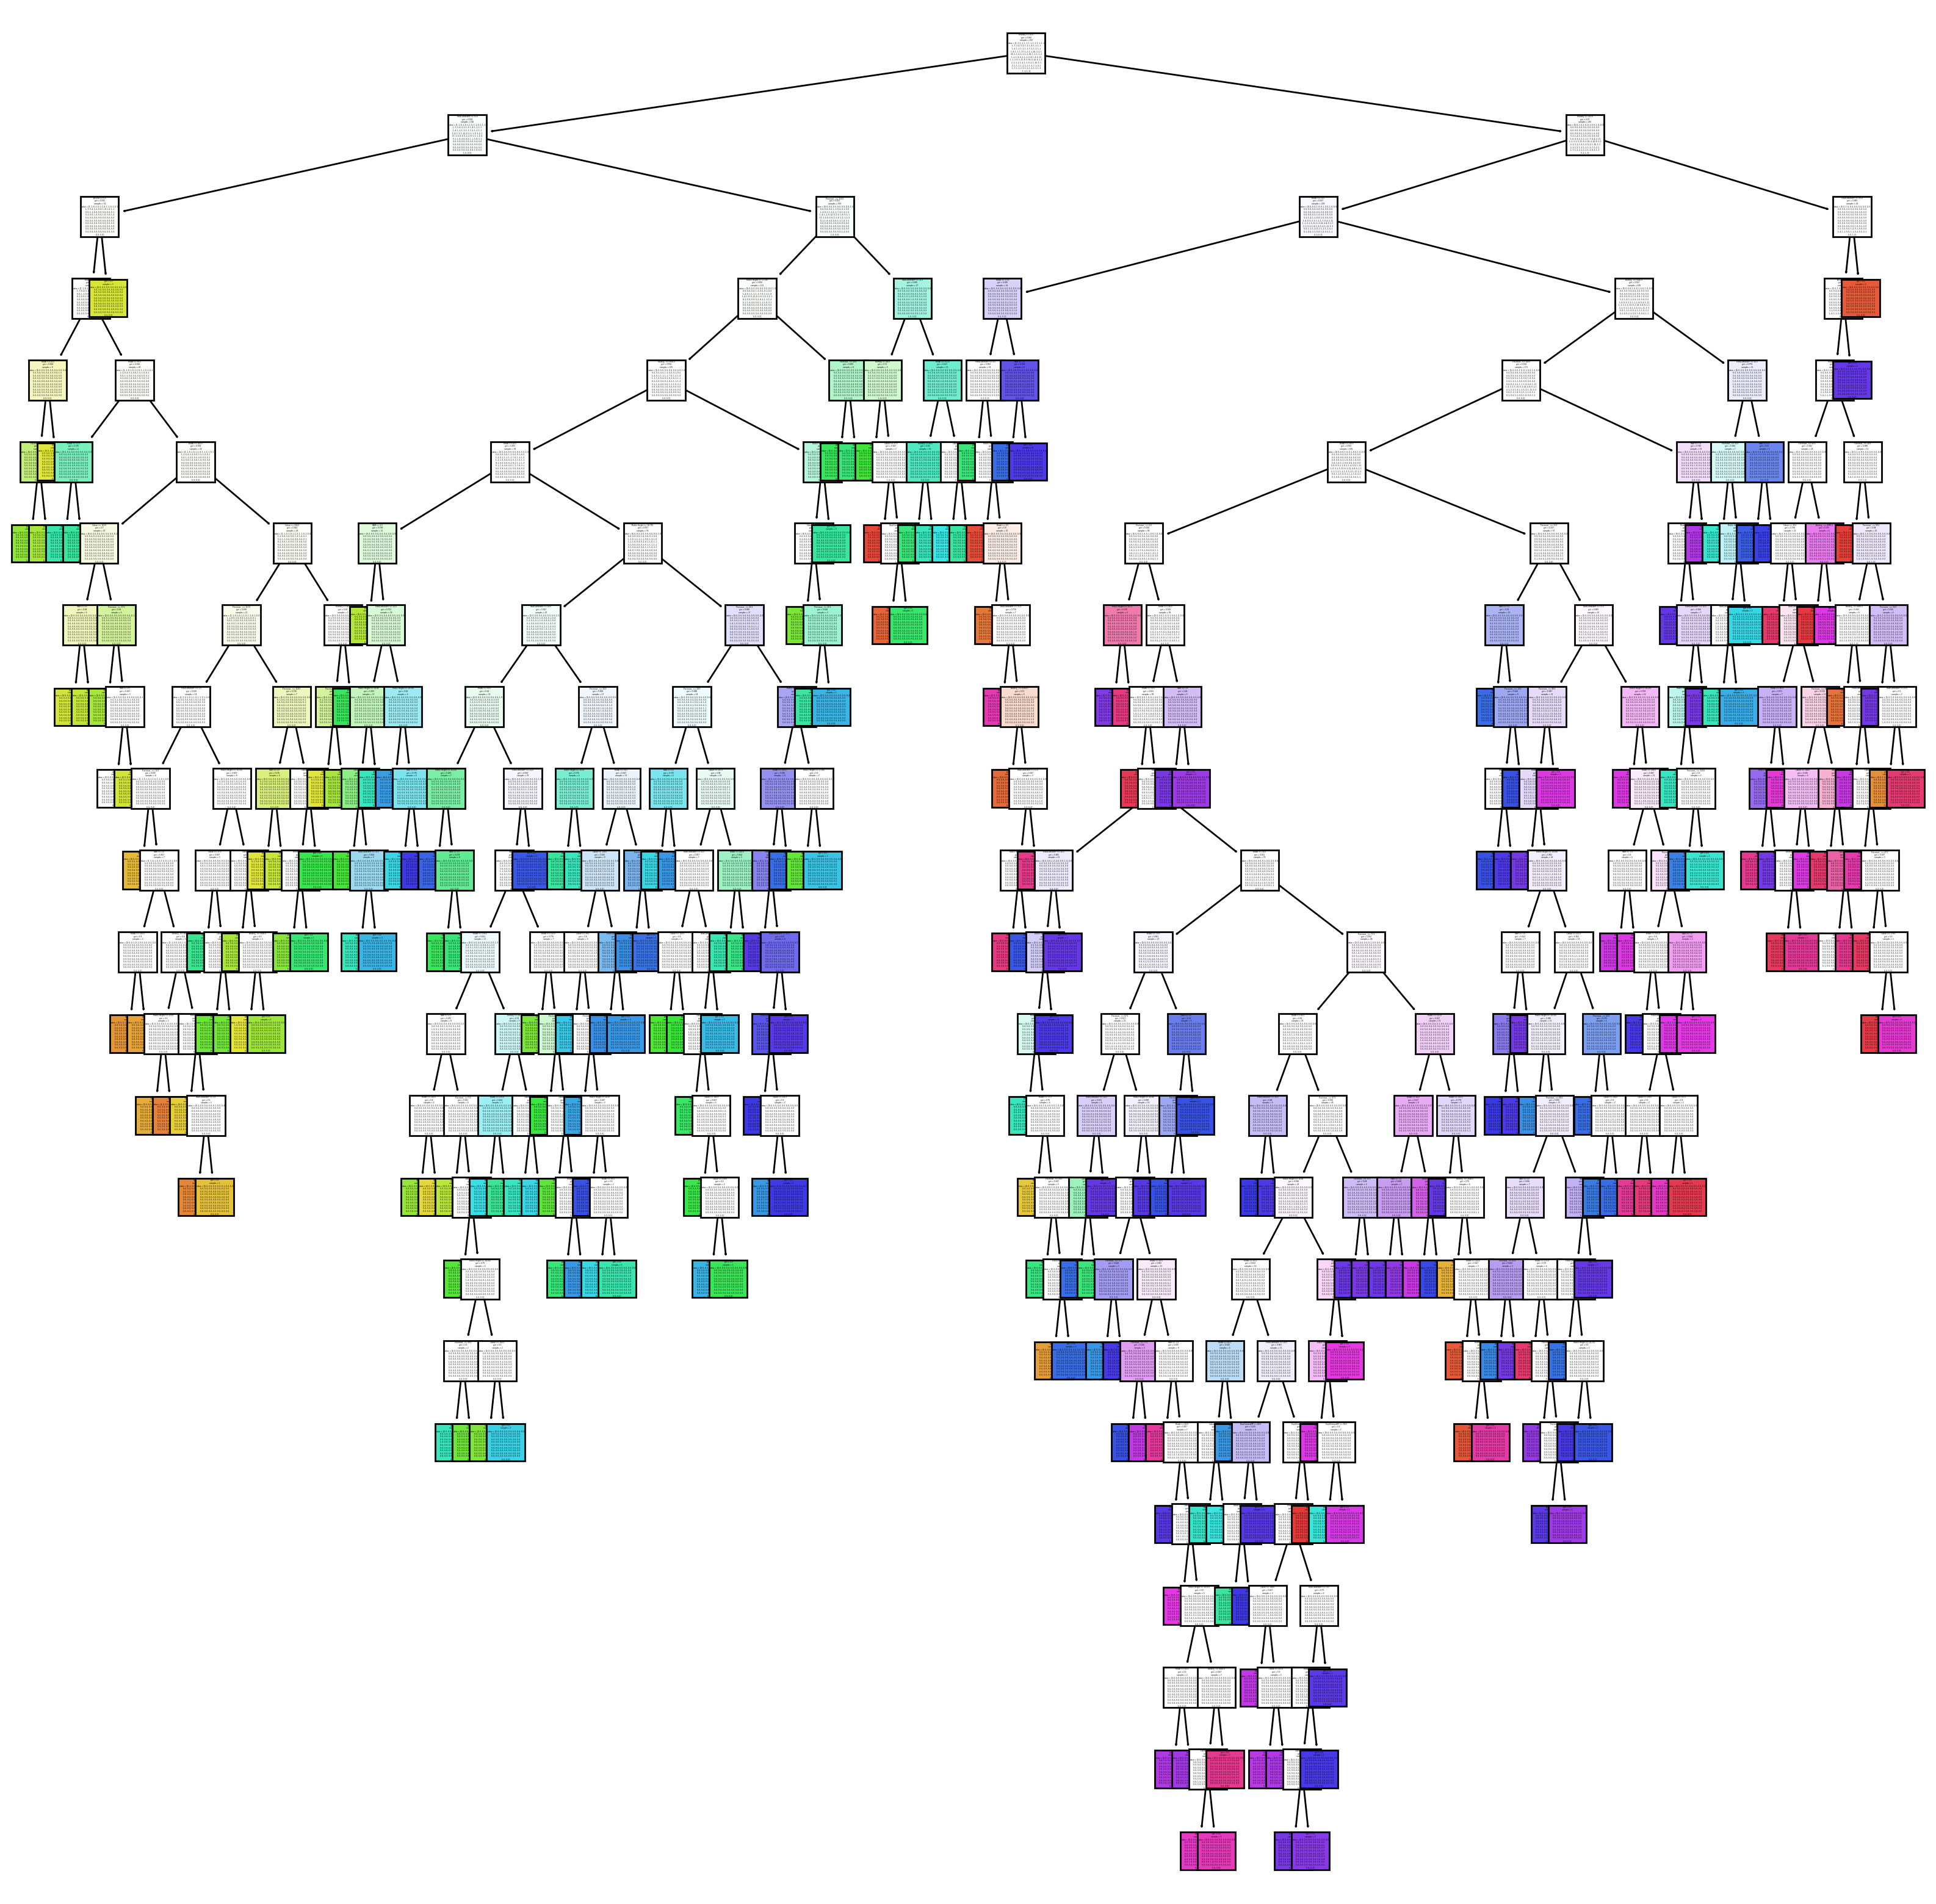
DECISION TREE
Score = 0.61
 | Feature Importance
Model | 0.219095
Processor_ | 0.184691
RAM | 0.119651
Mobile Height | 0.116859
Colour | 0.114248
FrontCameraMP | 0.081010
RearCameraMP | 0.069034
Battery_ | 0.042313
Memory | 0.040941
AI Lens | 0.012159
 | Feature Importance
Model | 0.219095
Processor_ | 0.184691
RAM | 0.119651
Mobile Height | 0.116859
Colour | 0.114248
FrontCameraMP | 0.081010
RearCameraMP | 0.069034
Battery_ | 0.042313
Memory | 0.040941
AI Lens | 0.012159

Slide 11
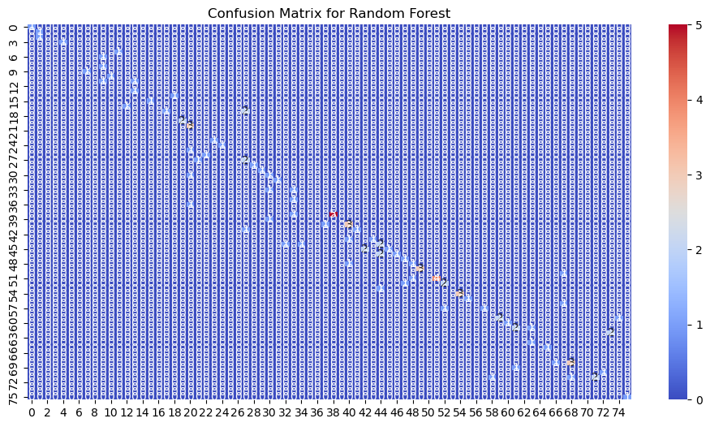
RANDOM FOREST
Classification Report Score = 0.53
Score = 0.57
 | Feature Importance
Model | 0.168056
Colour | 0.163538
Processor_ | 0.160473
Mobile Height | 0.126542
RAM | 0.100919
FrontCameraMP | 0.071675
RearCameraMP | 0.071483
Memory | 0.069416
Battery_ | 0.057153
AI Lens | 0.010744

Slide 12
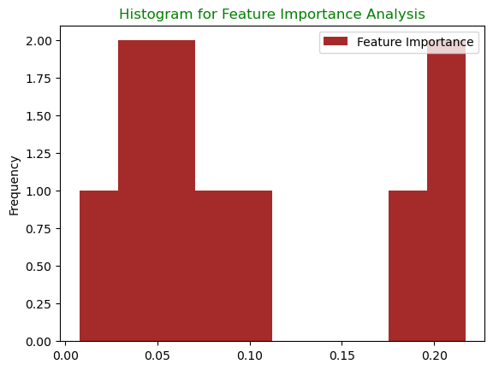
GRADIENT BOOSTING classification
Score = 0.61
 | Feature Importance
Model | 0.216958
Colour | 0.210234
Processor_ | 0.194729
RAM | 0.110268
Mobile Height | 0.074244
Memory | 0.068250
RearCameraMP | 0.049575
FrontCameraMP | 0.039309
Battery_ | 0.028763
AI Lens | 0.007671

Slide 13
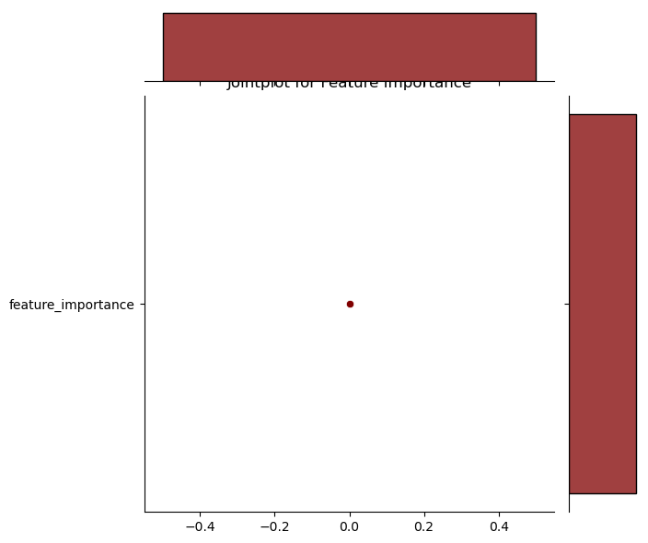
GRADIENT BOOSTING
REGRESSION
Jointplot for
Feature Importance
SCORE = 0.90
 | Feature Importance
FrontCameraMP | 0.460586
Model | 0.197077
Memory | 0.140548
Battery_ | 0.077638
RearCameraMP | 0.028453
Processor_ | 0.026109
RAM | 0.024242
Mobile Height | 0.024029
Colour | 0.021075
AI Lens | 0.000244

Slide 14
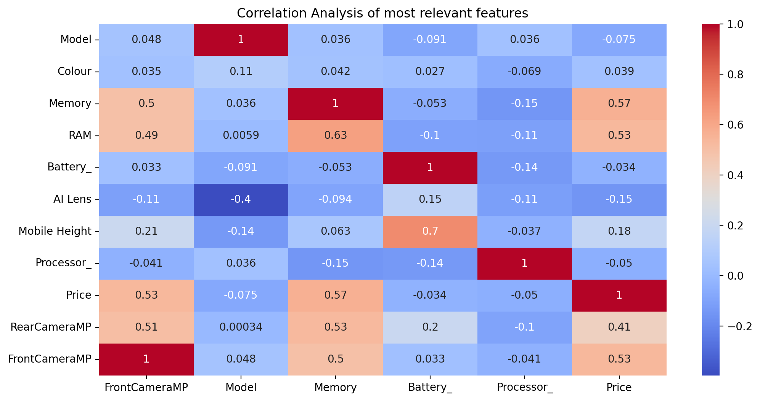
Gradient Boosting Regression is the best algorithm for this data

Slide 15

Recommendations: Front Camera, Model and Memory have the most significant influence on mobile phone prices. This information can inform pricing strategies and marketing decisions.

